Slide 1

Activities on meeting

Slide 2
Work on the following message by a superior to develop the agenda
Hey Erik. Karin here. I just wanted to let you know that I'm going to be out of the office for about ten days and wanted to ask if you could organize a team meeting for the first week of next month. As well as our regular updates I'd like us to discuss the remodel of the Northlake store. We need to give input on which design we prefer. I'd also like us to decide if we need more money in our budget, so it would be good if you could invite Lauren to join us too. Thanks and let me know if you have any questions. You can call me on my cell. See you in two weeks.

Slide 3
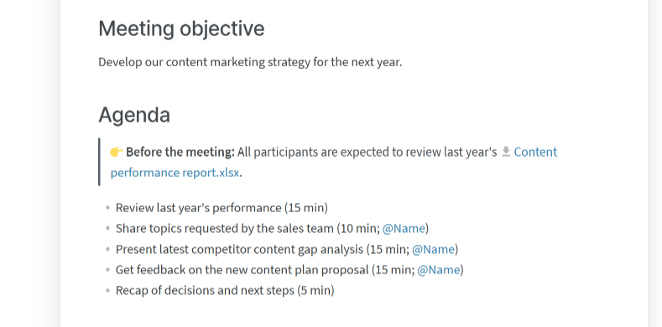
Sample agenda

Slide 4
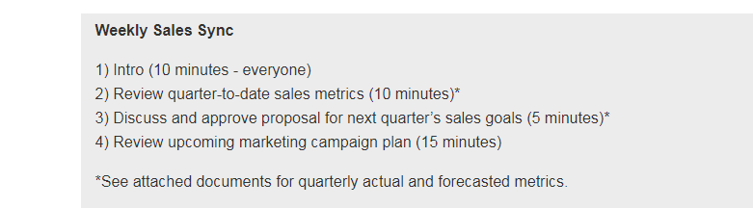
Sample agenda

Slide 5
Writing the meeting announcement email
Write a clear subject line.
Greet the participants.
Provide the details of the meeting (meeting name (if any), purpose, date, time, venue).
Announce meeting agenda.
Instruct participants about any research or preparation will be needed on their part. Also, mention names if necessary.
End with a cordial statement.

Slide 6
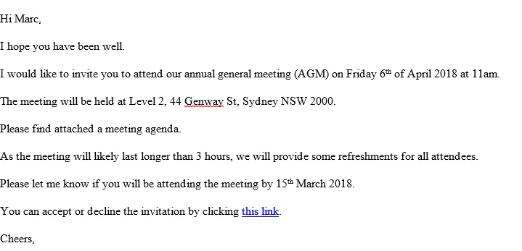
Sample email

Slide 7
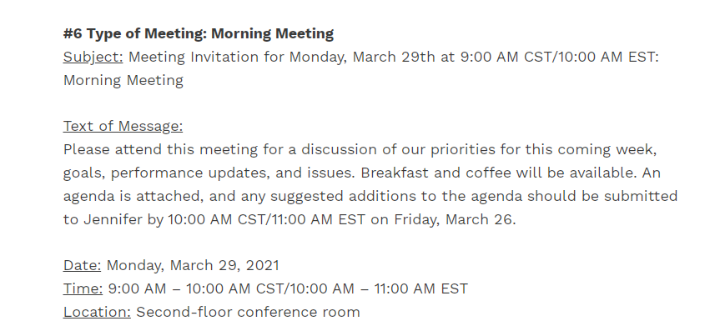
Sample email

